Slide 1
CS212 Lecture: Link Layer Technology - Introduction
Ravi Mittal
ravi.mittal@iitgoa.ac.in
Indian Institute of Technology, Goa

Slide 2
Contents
What is the role of DLL when you connect to a website?
Link Layer Protocols
CSMA/CD
Ethernet - Introduction

Slide 3
References
Class Presentation, CS 161, Computer Security, Connection: TLS, Prof Racula Ada Popa, Univ of California, Berkeley
Computer Networking: A Top-down Approach, Book, Jim Kurose and Ross, 8th Edition
Lecture slides: Prof Scott Shenker – Univ of Berkeley at California

Slide 4
What is the role of Data Link Layer when you connect to a website?

Slide 5


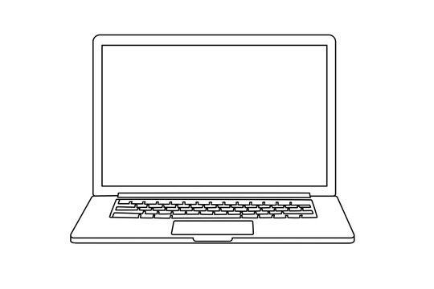
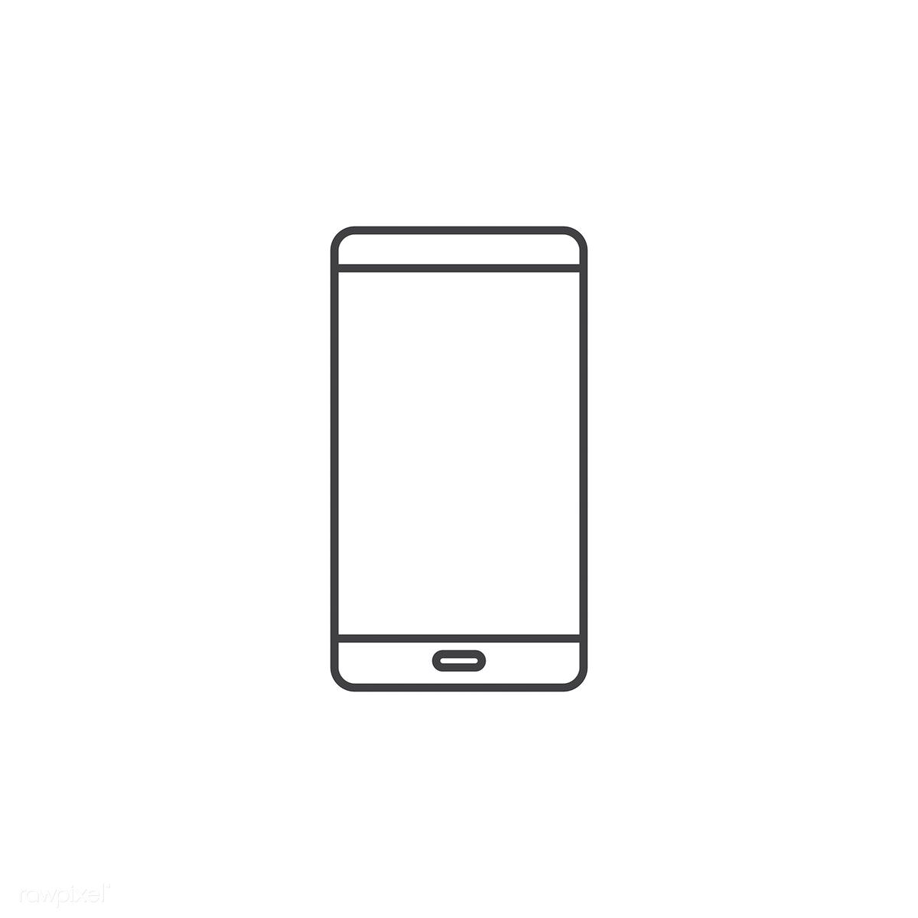
Connecting to a www server !
Connection to ISP
Server

Slide 6
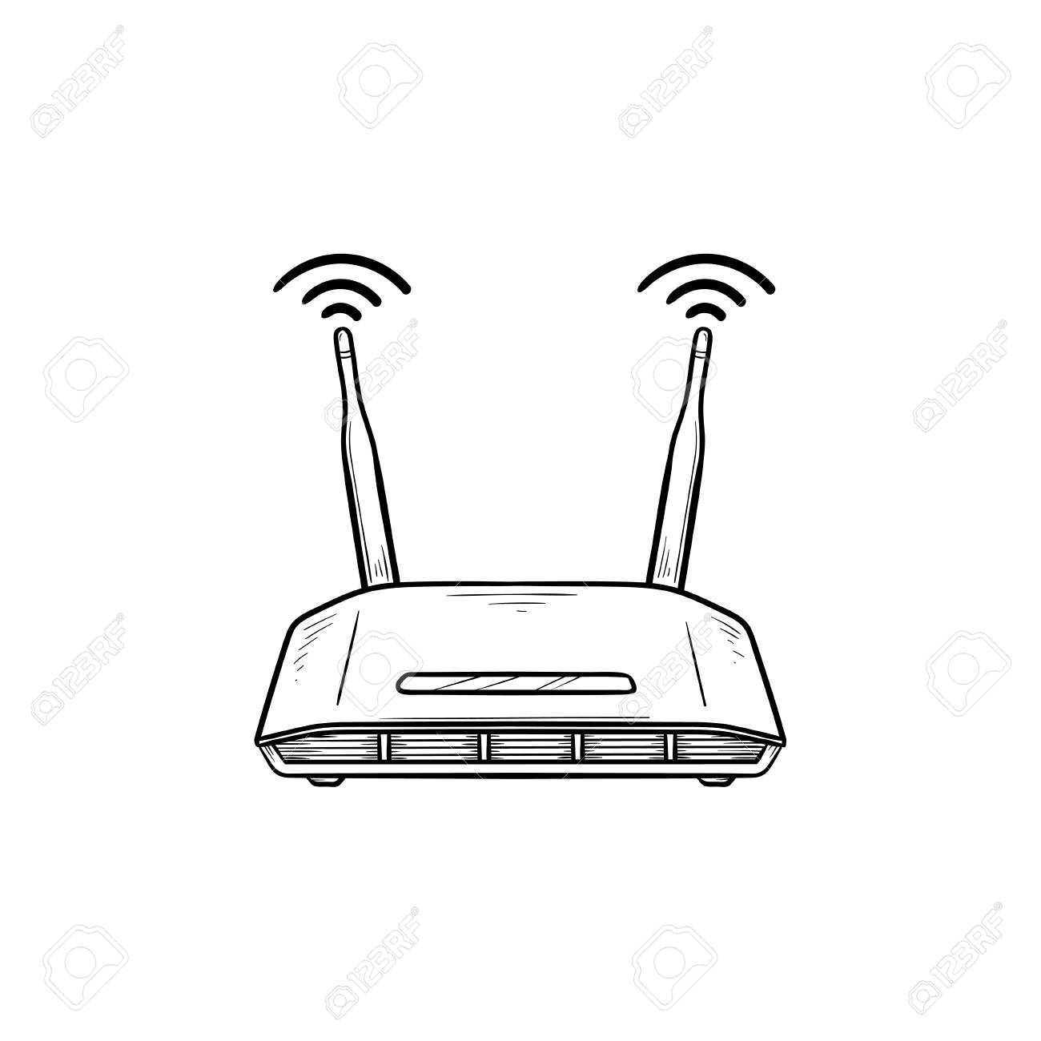
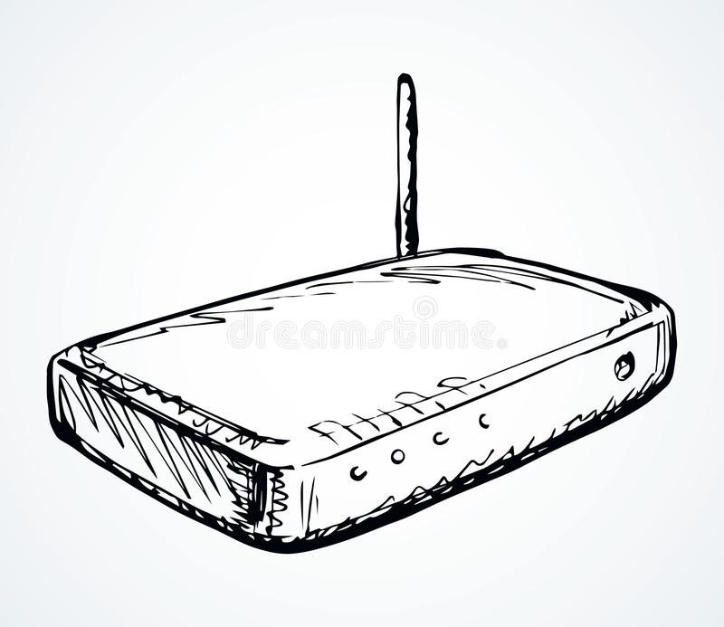
What devices you use to connect to Internet?
WiFi Router
Connected to service
Providers eg Airtel
Over Fiber/Ethernet
ADSL Modem connected
to service provider over
Telephone line

Slide 7
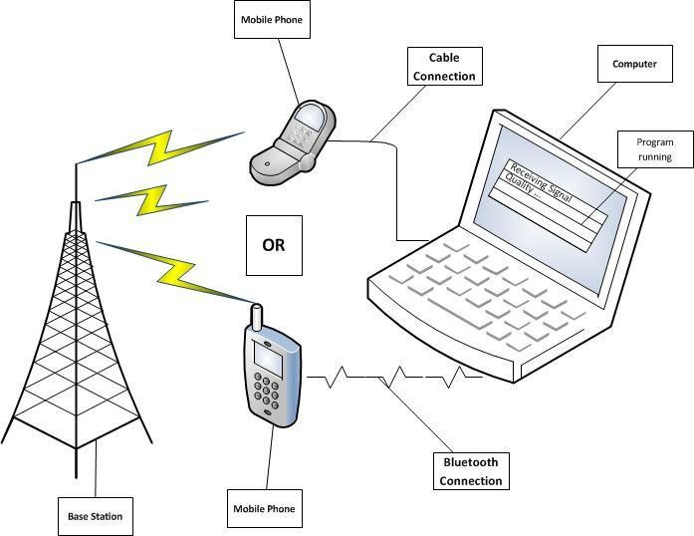
What devices you use to connect to Internet?
Use 3G/4G data-connection
Mobile Network

Slide 8



Slide 9
1. Join the wireless network
Your laptop shouts:
HEY, DOES WIRELESS NETWORK X EXIST?

Slide 10
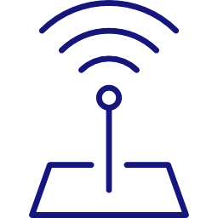
1. Join the wireless network
Wireless access point(s) continually shout: HEY, I’M WIRELESS NETWORK Y, JOIN ME!

Slide 11
1. Join the wireless network
If either match up, your laptop joins the network. Optionally performs a cryptographic exchange.

Slide 12
2. Configure your connection
Your laptop shouts:
HEY, ANYBODY, WHAT BASIC CONFIG DO I NEED TO USE?
I need IP address and
other parameters

Slide 13

2. Configure your connection
Some system on the local network replies: Here’s your config, enjoy
DHCP server

Slide 14
The configuration includes:
An Internet address (IP address) your laptop should use; typ. 32 bits (IPv4). May also include 64b of the 128b IPv6 address
The address of a “gateway” system to use to access hosts beyond the local network
The address of a DNS server (“resolver”) to map names like google.com to IP addresses
2. Configure your connection
192.168.1.14

Slide 15
3. Find the address of google.com
Your laptop sends a DNS request asking: “address for google.com?”
It’s transmitted using the UDP protocol (lightweight, unreliable).
The DNS resolver might not be on the local network.
192.168.1.14

Slide 16
3. Find the address of google.com
gateway
192.168.1.14

Slide 17
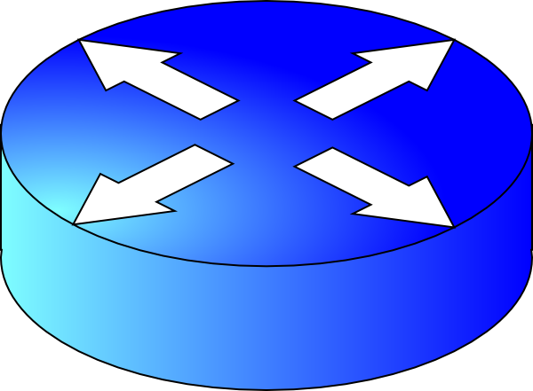
3. Find the address of google.com
gateway
192.168.1.14
The Rest of
the Internet
resolver
router
172.217.6.78

Slide 18
3. Find the address of google.com
google.com?
gateway
192.168.1.14
The Rest of
the Internet
resolver
router
172.217.6.78

Slide 19
3. Find the address of google.com
gateway
192.168.1.14
google.com?
The Rest of
the Internet
resolver
router
(The resolver now itself uses DNS queries to other DNS servers to figure out the address associated with google.com.)
172.217.6.78

Slide 20
3. Find the address of google.com
gateway
192.168.1.14
The Rest of
the Internet
resolver
router
google.com’s address is 172.217.6.78
172.217.6.78

Slide 21
4. Connect to google.com server
gateway
192.168.1.14
The Rest of
the Internet
resolver
router
172.217.6.78

Slide 22
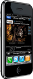
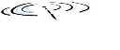



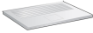







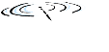

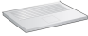
Integrated view of the Internet
mobile network
4G
national or global ISP
IP
Streaming
video
Skype
local or regional ISP
home network
content
provider
network
HTTP
datacenter
network
Ethernet
TCP
enterprise
network
WiFi
Source: Kurose and Ross Book: 8th Edition

Slide 23
We know.. IP layer does Routing It interconnects different networks

Slide 24
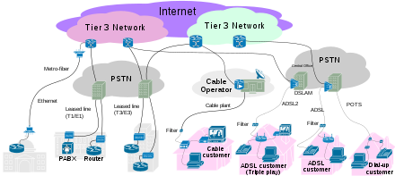
The Internet – to glue different type of Networks

Slide 25
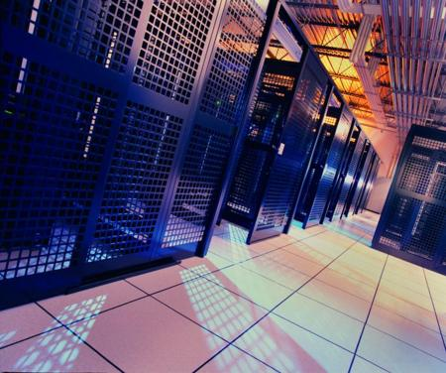
The Internet – to glue different type of Networks
Servers
Top of Rack
Agg. Switches
Mobile Backhaul ,
Base Station
The Internet
IP Routers and Switches
Data Center Network
Mobile Backhaul
Access Network
Metro Ethernet
Core Network
Mobile Network
Fixed Network
Enterprise Network
Workgroup switches
edge routers, connectivity
Broadband
GPON, EPON, DSL,
DSLAMs, CABLE

Slide 26

Distributed mechanism of Internet
link
end-system
switch
path
packet
Source: Prof Scott Shenker – Univ of Berkeley at California

Slide 27
Where are links?
Source: Book: Peterson and Davie

Slide 28
With a path links can be of different types
ADSL –
UTP
Ethernet-
Fiber
SONET- Fiber
Ethernet-
Cable
Cellular
WiFi
Satellite
Ethernet-
Fiber
Ethernet-
Fiber
Source: Book: Peterson and Davie

Slide 29
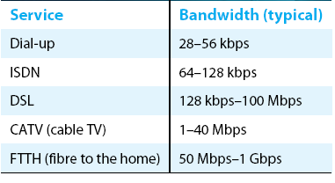
Links for home connection
Ethernet
WiFi
Cellular (3G, 4G, 5G)

Slide 30
Link Layer Protocols

Slide 31
Link Layer Protocol: Functions
Main functionality: Responsibility of transferring datagram from one node to adjacent node over a link. It achieves it using:
Framing, physical addressing:
Encapsulates datagram into frame, adding header, trailer
Channel access if shared medium
“MAC” addresses used in frame headers to identify source, dest
Reliable delivery between adjacent nodes
Seldom used on low bit-error link (fiber, some twisted pair)
wireless links: high error rates
Flow control
pacing between adjacent sending and receiving nodes
Error control
Use of Error correcting codes
Access Control
Layer-2 packet is a frame, encapsulates datagram

Slide 32
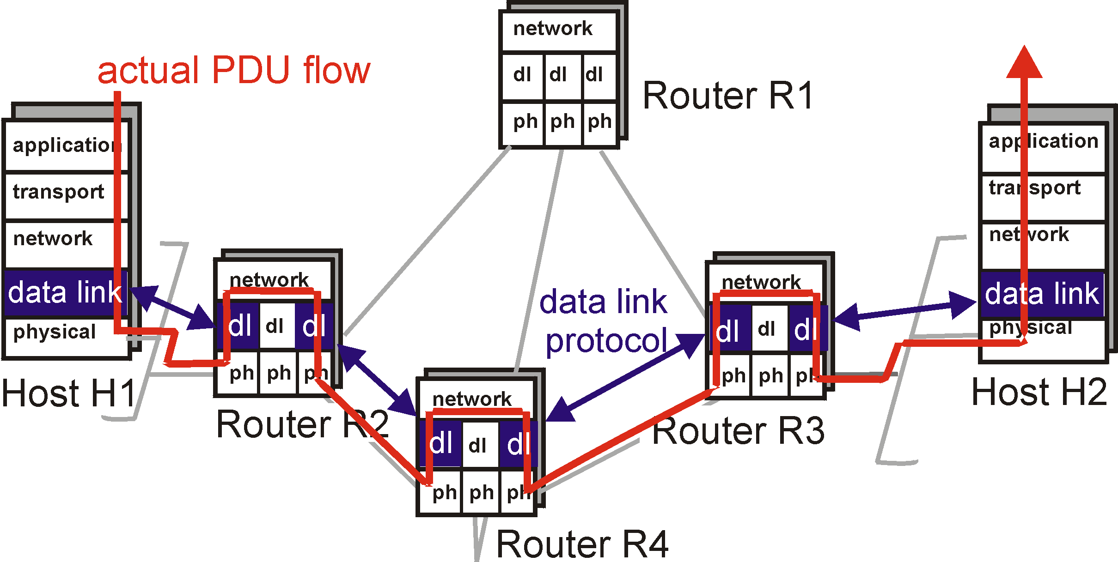
Data Link Layer

Slide 33
Data Link Layer
two physically connected devices:
host-router, router-router, host-host
unit of data: frame
M
application
transport
network
link
physical
network
link
physical
H
t
M
H
H
M
data link
protocol
n
t
H
H
H
H
H
H
M
l
n
t
M
l
n
t
frame
phys. link
adapter card

Slide 34
Various Link layers within a route
host
host
HTTP message
HTTP
HTTP
TCP segment
TCP
TCP
router
router
IP
IP packet
IP packet
IP packet
IP
IP
IP
Ethernet
interface
Ethernet
interface
SONET
interface
SONET
interface
Ethernet
interface
Ethernet
interface

Slide 35
Digital adaptors Communicating
datagram
link layer protocol
frame
frame
sending
node
adapter
adapter
receiving
node
Link layer implemented in adaptor (network interface card)
Ethernet card, 802.11 card
Sending side:
Encapsulates datagram in a frame
Adds error checking bits, flow control, etc.
Receiving side
Looks for errors, flow control, etc.
Extracts datagram and passes to receiving node

Slide 36
Multiple Access Protocols

Slide 37
MAC protocols: taxonomy
Three broad classes:
Channel partitioning
divide channel into smaller “pieces” (time slots, frequency, code)
allocate piece to node for exclusive use
TDMA, FDMA, CDMA
“taking turns”
nodes take turns, but nodes with more to send can take longer turns
Random access (our interest)
channel not divided, allow collisions
“recover” from collisions

Slide 38
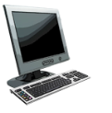


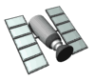
Multiple access links, protocols
Two types of “links”:
Point-to-point
Point-to-point link between Ethernet switch and host
PPP for dial-up access
Broadcast (shared wire or medium)
Old-fashioned Ethernet
Upstream HFC in cable-based access network
802.11 wireless LAN, 4G/4G. satellite
shared wire (e.g.,
cabled Ethernet)
shared radio: 4G/5G
shared radio: WiFi
shared radio: satellite
humans at a cocktail party
(shared air, acoustical)

Slide 39
Multiple access protocols
Single shared broadcast channel
Two or more simultaneous transmissions by nodes: interference
Collision if node receives two or more signals at the same time
Multiple access protocol
Distributed algorithm that determines how nodes share channel, i.e., determine when node can transmit
Communication about channel sharing must use channel itself!
No out-of-band channel for coordination

Slide 40
CSMA (carrier sense multiple access)
Simple CSMA: listen before transmit:
if channel sensed idle: transmit entire frame
if channel sensed busy: defer transmission
human analogy: don’t interrupt others!
CSMA/CD: CSMA with collision detection
collisions detected within short time
colliding transmissions aborted, reducing channel wastage
collision detection easy in wired, difficult with wireless

Slide 41
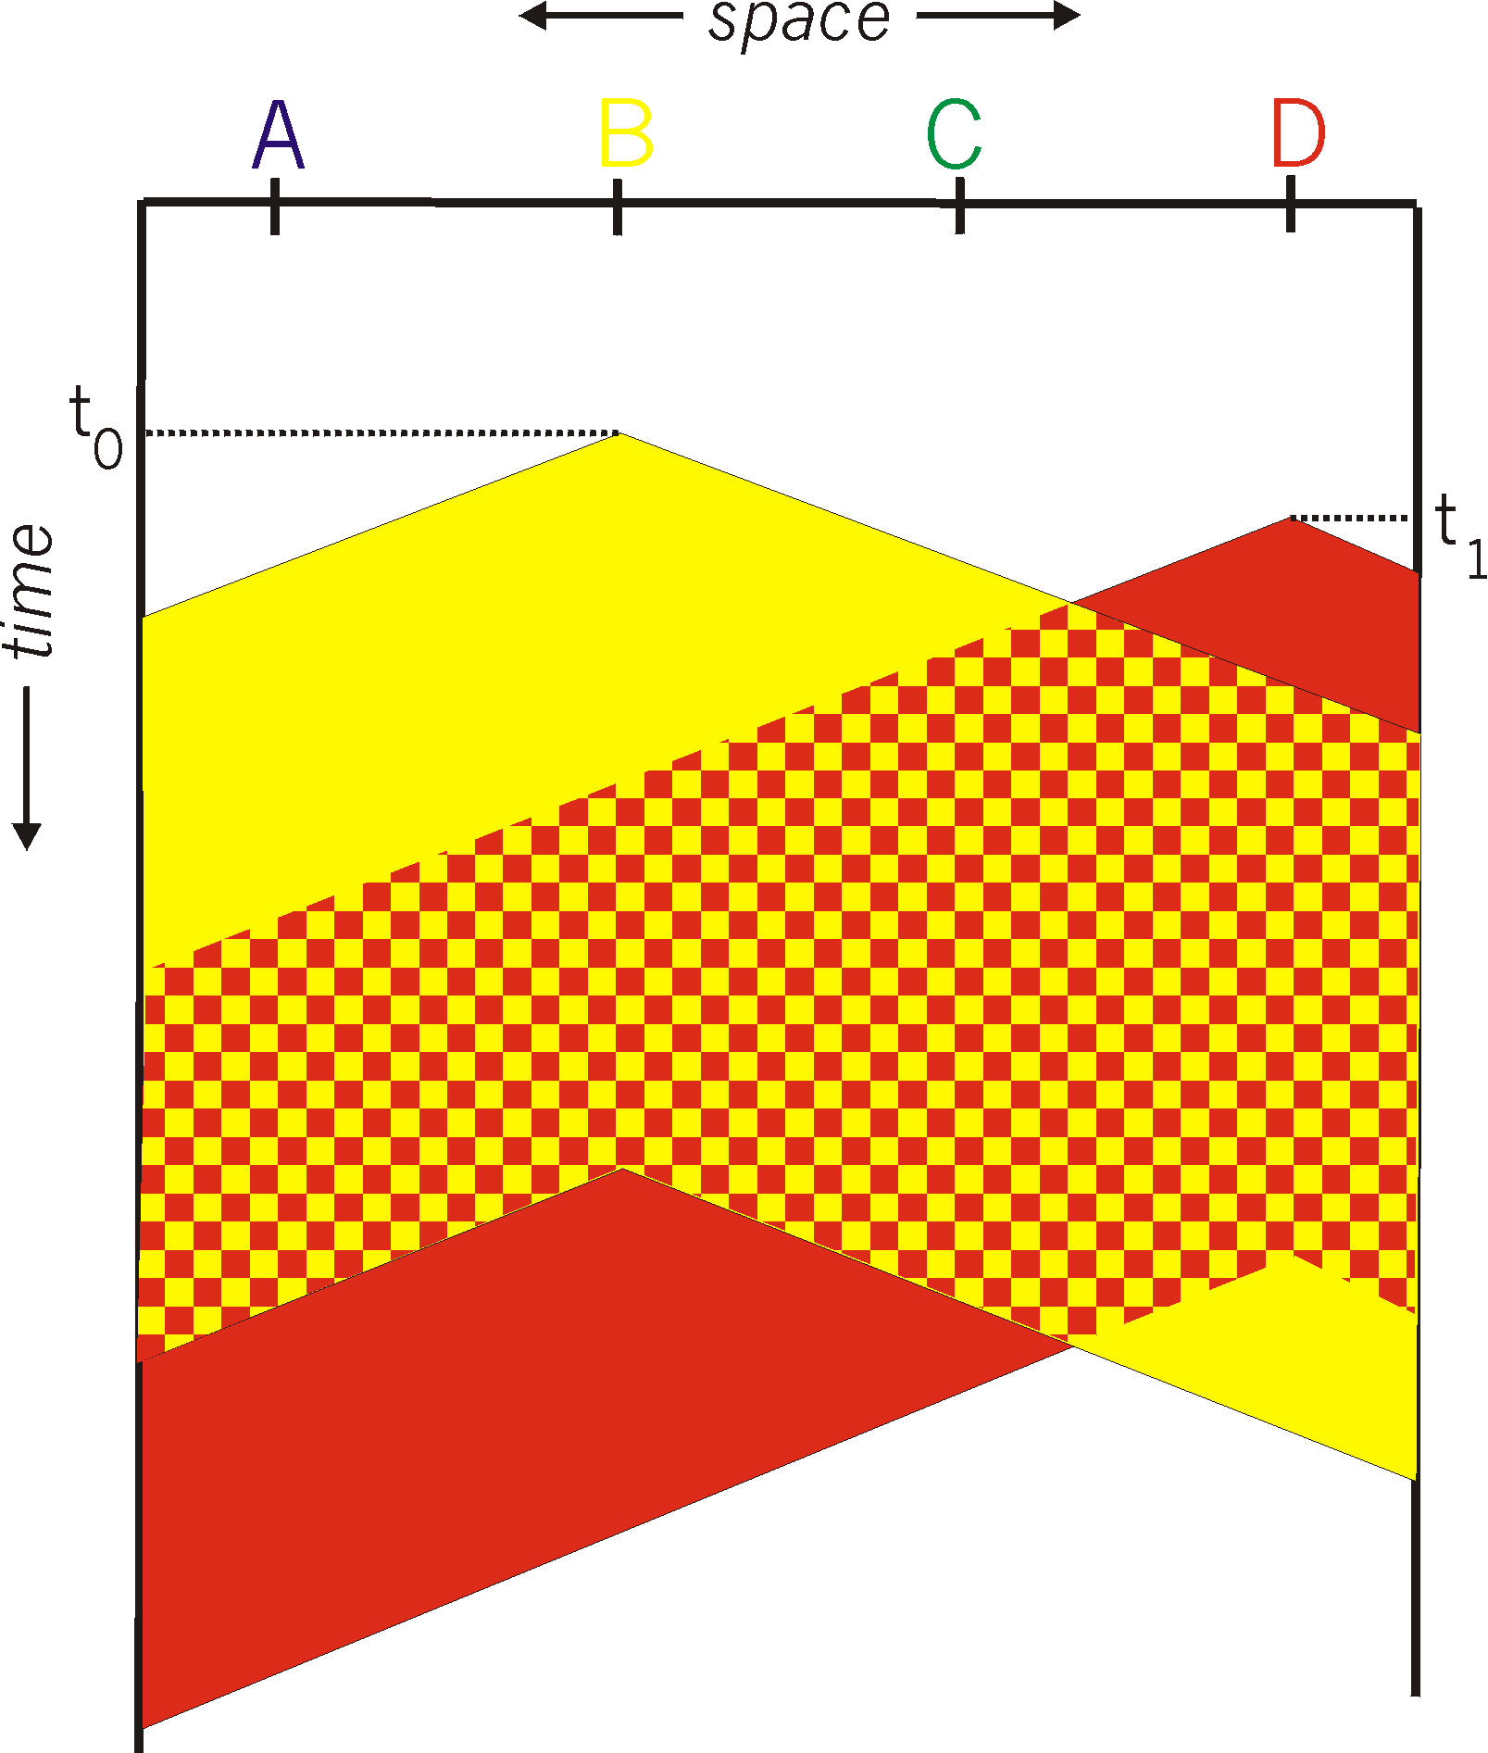
CSMA: collisions
Collisions can still occur with carrier sensing:
Propagation delay means two nodes may not hear each other’s just-started transmission
Collision: entire packet transmission time wasted
Distance & propagation delay play role in in determining collision probability
spatial layout of nodes

Slide 42
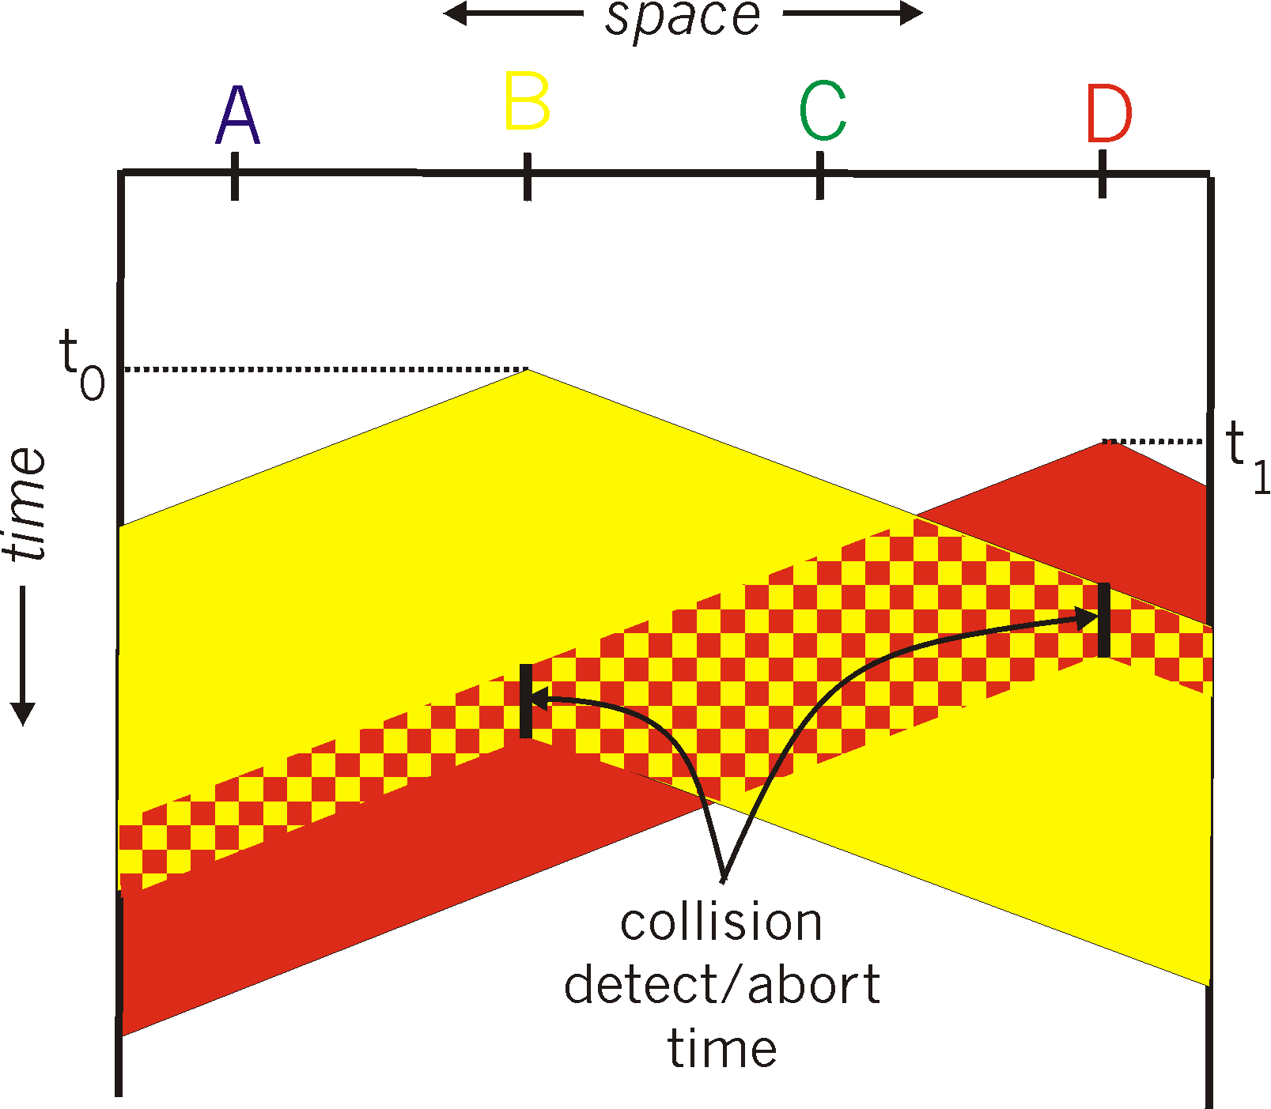
CSMA/CD:
CSMA/CD reduces the amount of time wasted in collisions
transmission aborted on collision detection
spatial layout of nodes

Slide 43
Ethernet CSMA/CD algorithm
NIC receives datagram from network layer, creates frame
If NIC senses channel:
if idle: start frame transmission.
if busy: wait until channel idle, then transmit
If NIC transmits entire frame without collision, NIC is done with frame !
If NIC detects another transmission while sending: abort, send jam signal
After aborting, NIC enters binary (exponential) backoff:
after m^{th} collision, NIC chooses K at random from {0,1,2, …, 2^{m-1}}. NIC waits K·512 bit times, returns to Step 2
more collisions: longer backoff interval

Slide 44
Local Area Network (LAN): Ethernet

Slide 45
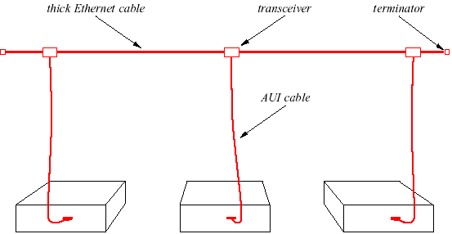
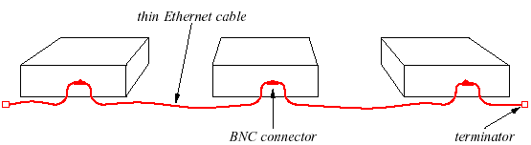
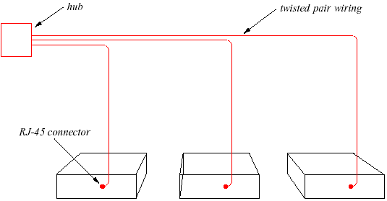
Ethernet Generations
Original Ethernet:
Coaxial cable (10Base5)
Thicknet.
Next Generation:
Thin coax cable (10Base2)
Thinnet.
Modern Ethernet:
Twisted pair ethernet (10BaseT)
Uses hub: physical star but logical bus.

Slide 46
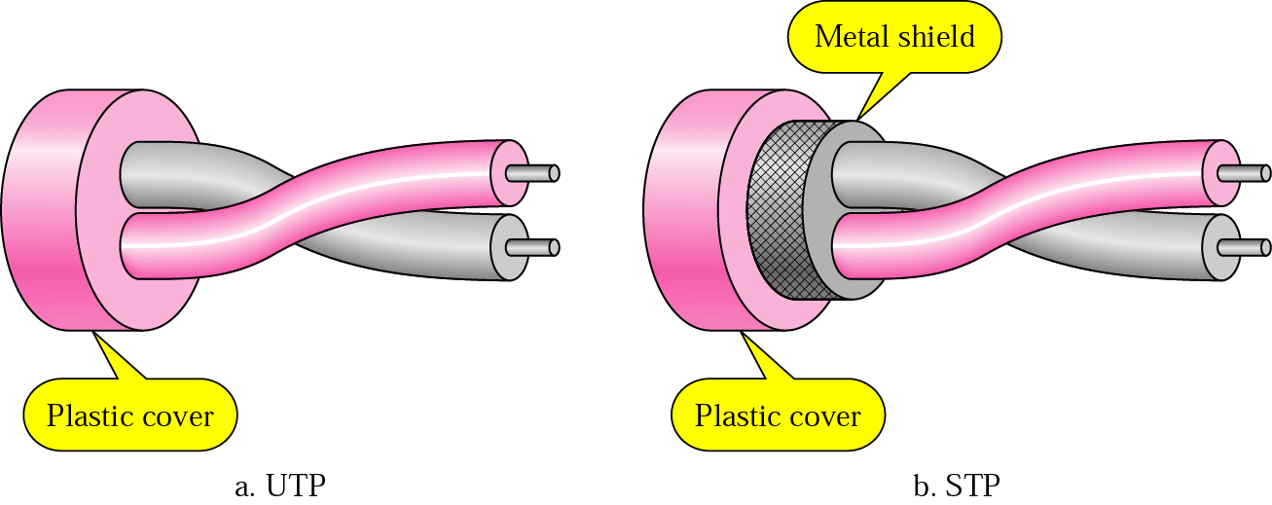
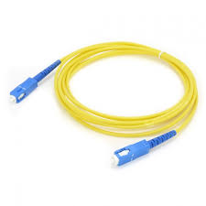
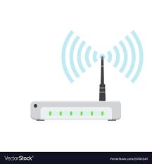
Physical Media for Ethernet
Fiber
Wireless

Slide 47

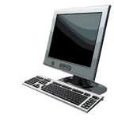

Ethernet Switches
Initially, hubs (passive) were used in Ethernet
Just a signal repeater
Now, active switch in center
Each “spoke” runs a (separate) Ethernet protocol
No collision
switch
star
bus: coaxial cable

Slide 48
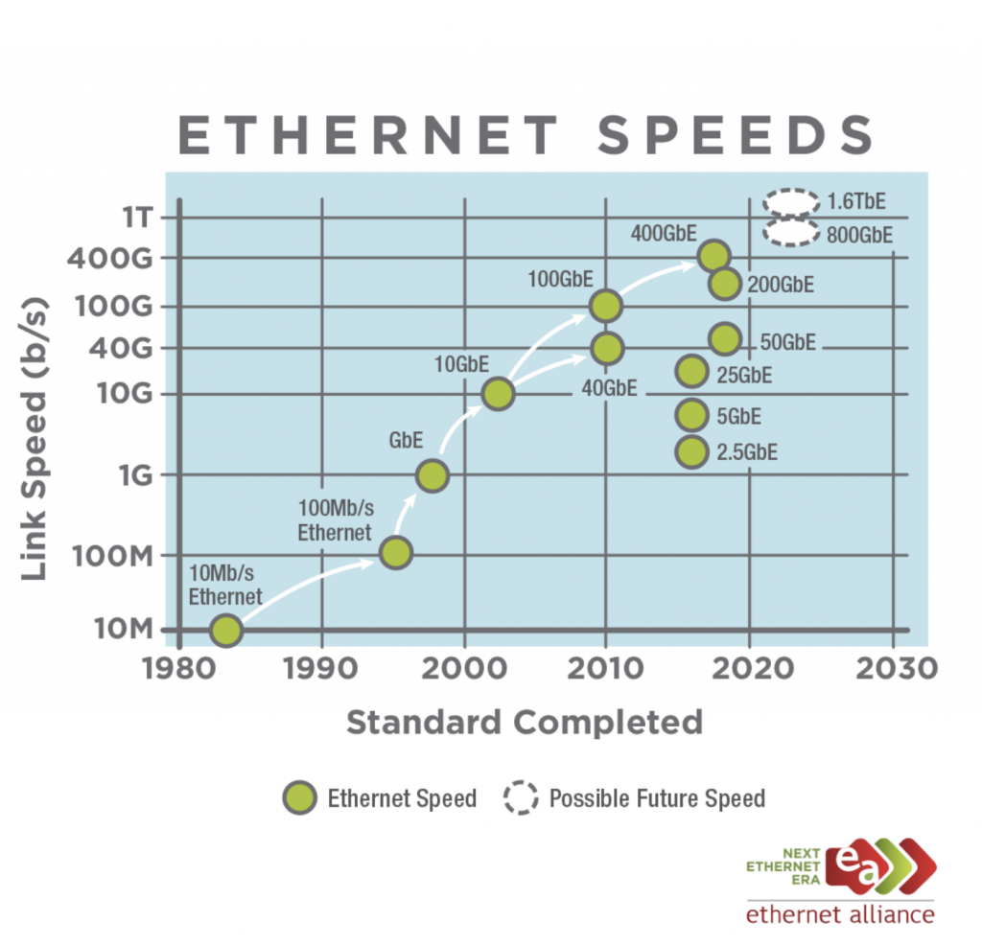

Slide 49
Lecture Summary
Link Layer is responsible for transferring datagram/frame from one end of the link to the other end of the link
Error detection, correction
Sharing a broadcast channel: multiple access
Link layer addressing
Ethernet is the most important LAN technology
It uses CSMA/CD protocol
Simple Algorithm
In modern switch based Ethernet → No collisions
Evolved from 10 Mbps link speed to 400 Gbps link speed
Ethernet + IP → Great combination
Inexpensive implementation

Slide 50
Backup Slides

Slide 51
Corporate Network

Slide 52
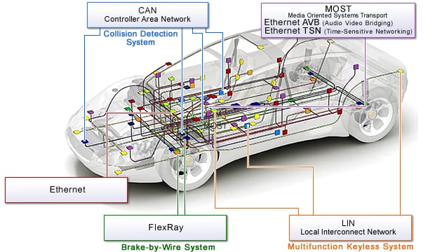
In-Vehicle Network (VAN)
Ref: In-Vehicle Networking Solutions, Renesas
:

Slide 53
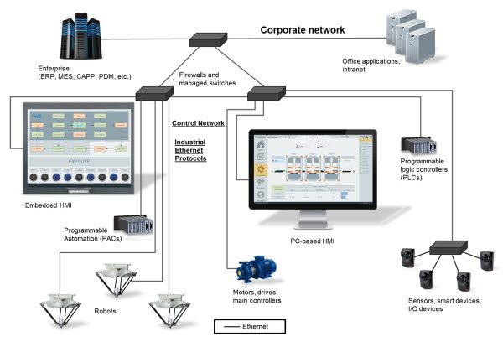
Industrial Ethernet
Image credit: AutomationDirect.com :

Slide 54
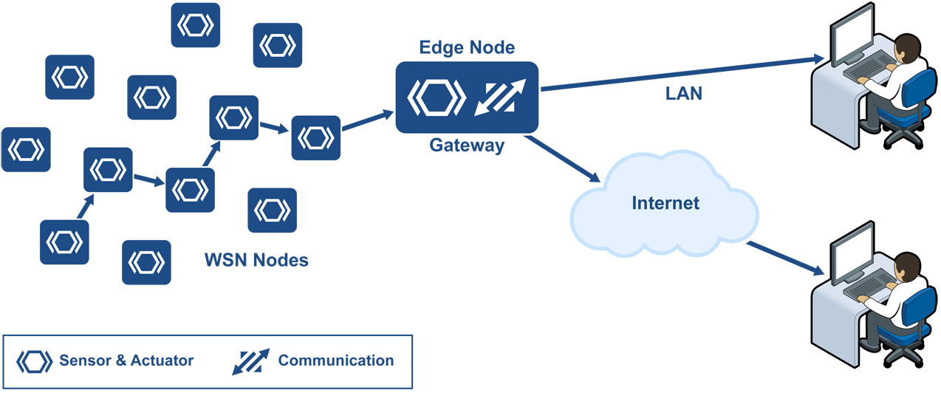
Many flavors of LANs
Ethernet IP
Powerlink
Ethercat
Wireless Sensor Network

